Slide 1
Sub group: Let G be a group under the binary operation ‘*’. A non-empty subset H of a group G is said to be a subgroup of G if H is itself a group under the SAME binary operation of a group G. For example: (1) (Z,+) is a subgroup of (Q,+). (2) (Q,+) is a subgroup of (R,+). (3) (R,+) is a subgroup of (C,+). Improper (trivial) subgroup: Any group (G,*) have two subgroups _________ and __________. These are improper or trivial subgroups. Others are called proper or non-trivial subgroups.

Slide 2
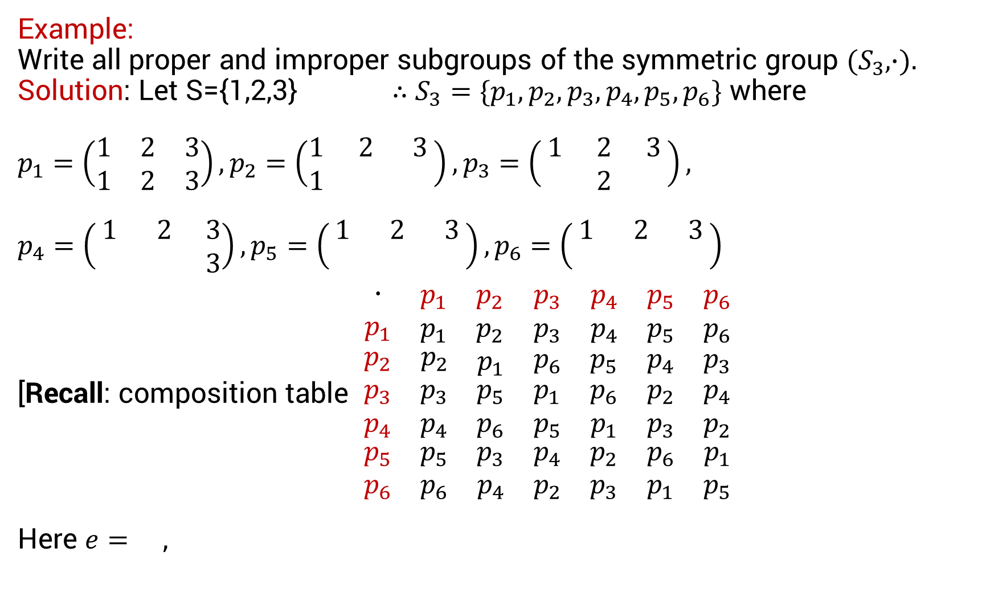
Example: Write all proper and improper subgroups of the symmetric group $(S_{3}, ∙).$ Solution: Let S={1,2,3}$∴S_{3}=\{p_{1},p_{2},p_{3},p_{4},p_{5},p_{6}\}$ where $p_{1}=\left(\begin{matrix}1 & 2 & 3 \\ 1 & 2 & 3\end{matrix}\right),p_{2}=\left(\begin{matrix}1 & 2 & 3 \\ 1 & & \end{matrix}\right),p_{3}=\left(\begin{matrix}1 & 2 & 3 \\ & 2 & \end{matrix}\right),$ $p_{4}=\left(\begin{matrix}1 & 2 & 3 \\ & & 3\end{matrix}\right),p_{5}=\left(\begin{matrix}1 & 2 & 3 \\ & & \end{matrix}\right),p_{6}=\left(\begin{matrix}1 & 2 & 3 \\ & & \end{matrix}\right)$ [Recall: composition table $\begin{matrix}\begin{matrix}\begin{matrix}\begin{matrix}∙ \\ p_{1}\end{matrix} & \begin{matrix}p_{1} \\ p_{1}\end{matrix}\end{matrix} & \begin{matrix}p_{2} \\ p_{2}\end{matrix}\end{matrix} & \begin{matrix}\begin{matrix}p_{3} \\ p_{3}\end{matrix} & \begin{matrix}p_{4} \\ p_{4}\end{matrix}\end{matrix} & \begin{matrix}\begin{matrix}p_{5} \\ p_{5}\end{matrix} & \begin{matrix}p_{6} \\ p_{6}\end{matrix}\end{matrix} \\ \begin{matrix}\begin{matrix}p_{2} & p_{2}\end{matrix} & p_{1}\end{matrix} & \begin{matrix}p_{6} & p_{5}\end{matrix} & \begin{matrix}p_{4} & p_{3}\end{matrix} \\ \begin{matrix}\begin{matrix}\begin{matrix}p_{3} \\ p_{4} \\ \begin{matrix}p_{5} \\ p_{6}\end{matrix}\end{matrix} & \begin{matrix}p_{3} \\ p_{4} \\ \begin{matrix}p_{5} \\ p_{6}\end{matrix}\end{matrix}\end{matrix} & \begin{matrix}p_{5} \\ p_{6} \\ \begin{matrix}p_{3} \\ p_{4}\end{matrix}\end{matrix}\end{matrix} & \begin{matrix}\begin{matrix}p_{1} \\ p_{5} \\ \begin{matrix}p_{4} \\ p_{2}\end{matrix}\end{matrix} & \begin{matrix}p_{6} \\ p_{1} \\ \begin{matrix}p_{2} \\ p_{3}\end{matrix}\end{matrix}\end{matrix} & \begin{matrix}\begin{matrix}p_{2} \\ p_{3} \\ \begin{matrix}p_{6} \\ p_{1}\end{matrix}\end{matrix} & \begin{matrix}p_{4} \\ p_{2} \\ \begin{matrix}p_{1} \\ p_{5}\end{matrix}\end{matrix}\end{matrix}\end{matrix}$ Here $e=$ ,

Slide 3
Cont’d

Slide 4
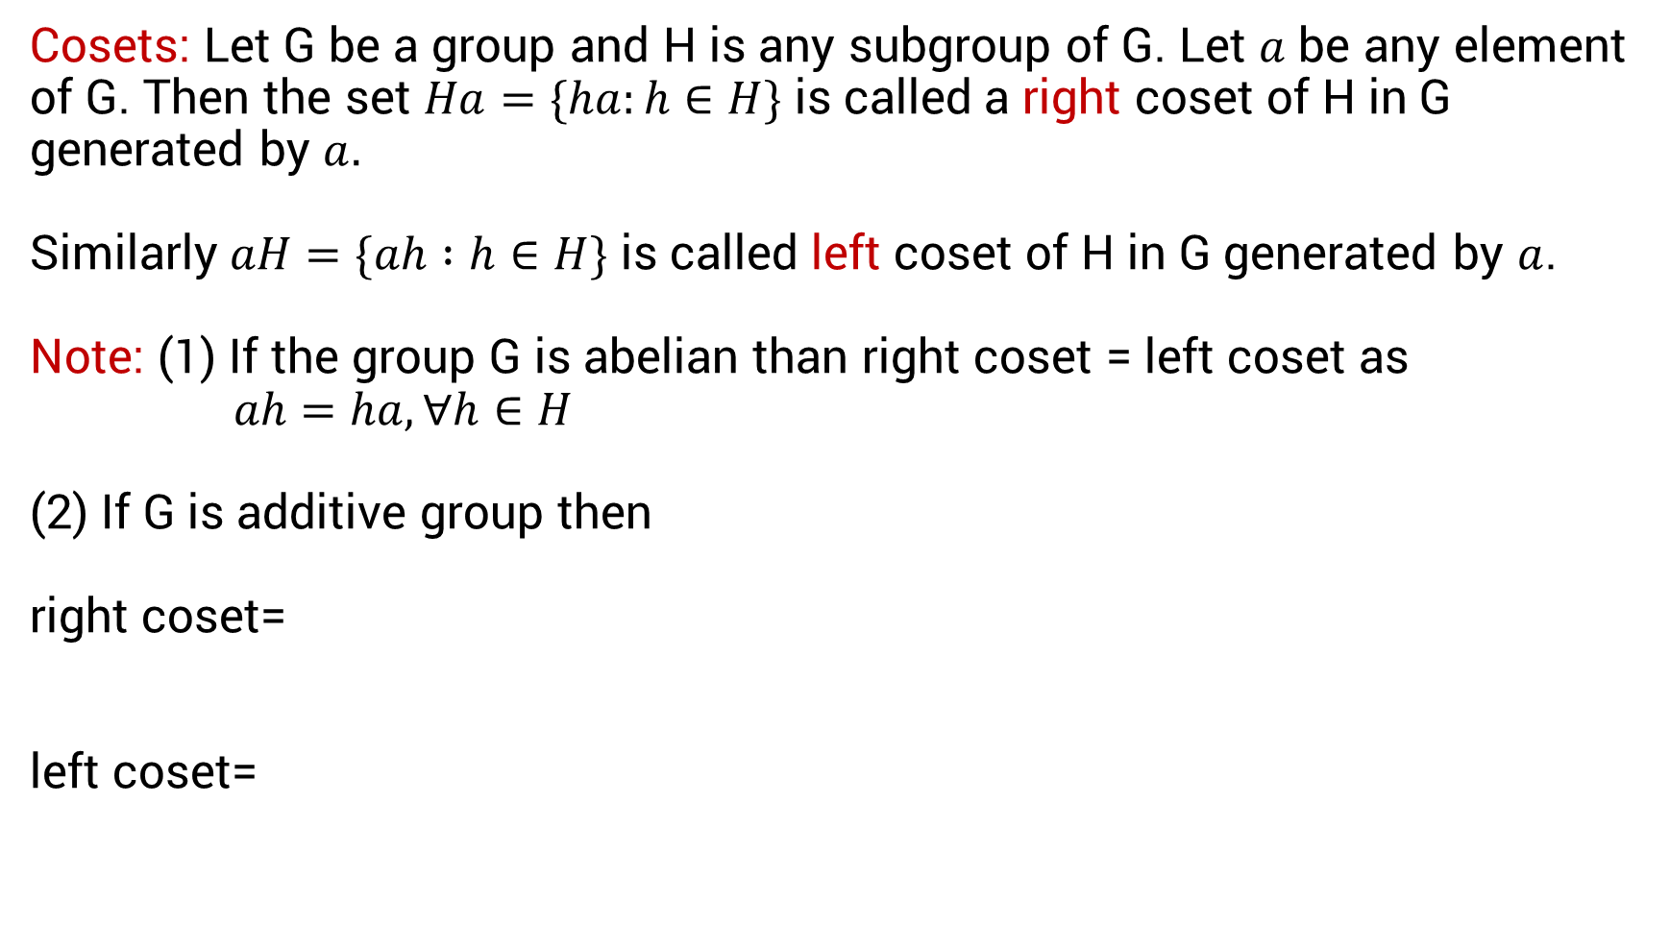
Cosets: Let G be a group and H is any subgroup of G. Let $a$ be any element of G. Then the set $Ha=\{ha:h∈H\}$ is called a right coset of H in G generated by $a.$ Similarly $aH=\{ah :h∈H\}$ is called left coset of H in G generated by $a$. Note: (1) If the group G is abelian than right coset = left coset as $ah=ha, ∀h∈H$ (2) If G is additive group then right coset= left coset=

Slide 5
Example: Let G be the additive group of integers and H= {…,-9,-6,-3,0,3,6,9,…} be a subgroup of G then find all right cosets of H in G. Solution:

Slide 6
Cont’d

Slide 7
Cont’d

Slide 8
Cont’d

Slide 9
Cont’d

